Slide 1

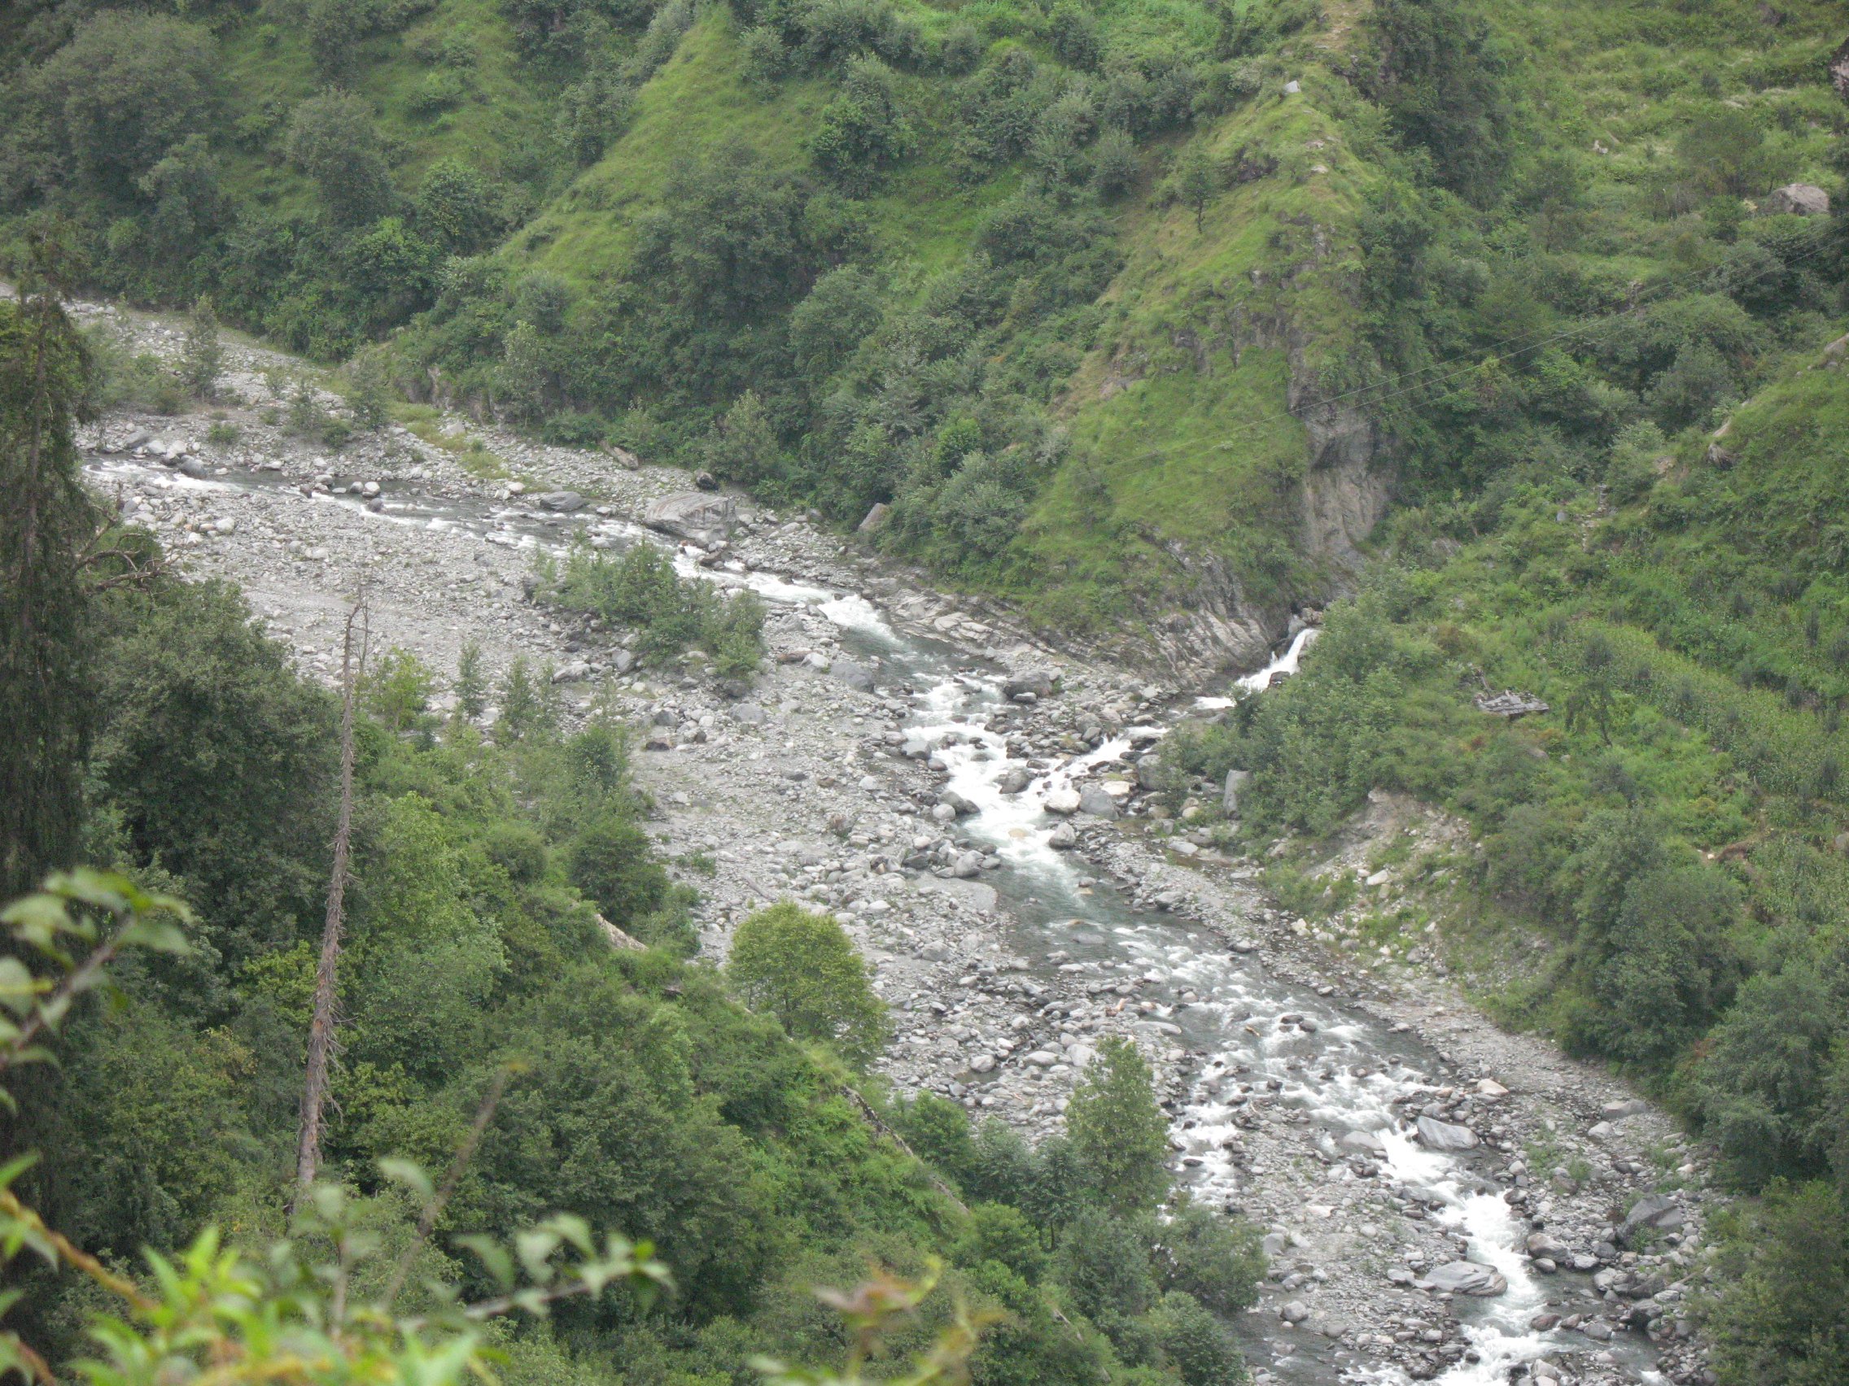
M/S NERI HYDRO PROJECTS PVT.LTD.
(2 X 2.3+0.4) MW NERI HYDRO ELECTRIC PROJECT
DISTRICT - MANDI, HIMACHAL PRADESH, INDIA
COMPANY PROFILE
M/S NERI HYDRO PROJECTS PVT.LTD.
Sungal Tea Estate V.P.O. Sungal
Tehsil. Palampur,
Distt. Kangra H.P. – 176061
Tel:- 09879001370 email:- neriadm.hep5mw@gmail.com
DECEMBER 2009
PROMOTERS AND DEVELOPERS
REGD.OFFICE :-M/S NERI HYDRO PROJECTS PVT.LTD.
Sungal Tea Estate V.P.O. Sungal
The.Palampur
Distt. Kangra H.P.-176 061
SITE OFFICE:-VPO Majharnoo Tehsil JoginderNagar District Mandi
H.P. Pin 175015

